Slide 1
Adaptive Median Filter
By Kiran Kintali

Slide 2
Goal of This Material
Implement the adaptive median filter in hardware
Discuss modeling considerations when targeting for HDL (VHDL/Verilog)
Learn about HDL workflow

Slide 3
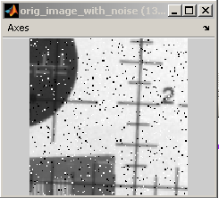
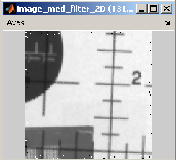
Why Use an Adaptive Median Filter?
Adaptive
median filter
Removes “salt and pepper” noise from the image
Notes:
Median filtering (and its more sophisticated version adaptive median filtering) is based on a well-known statistical operation of finding the median. It is a clever, yet simple and intuitive noise reduction method that reduces the noise by computing local statistics (distribution) of data and rejecting noise, by defining it as the outlier values in the localized distribution. (6min.)
For each pixel in the image, calculate the median value in a surrounding neighborhood of the pixel.
Replace the pixel with the median value.
The algorithm is simple and therefore has low computational complexity. However, note that it affects all image pixels regardless of noise content, and that’s why in images or video frame with high noise content (low SNR), it blurs the image substantially. So it only performs well on low noise densities.
How about adaptive median filtering? It still computes the median over the surrounding neighborhood, however, it is smart enough to check whether it is wise to replace the pixel value with the median. The adaptation part of the algorithm is a logical check; it just looks at the result of median computation, and if the median is skewed too much by noise (low SNR), it decides to define the median over a larger region to overcome the skewing of the local statistics. The algorithm continues adapting until skewing is removed.
This slide shows the advantage of using an adaptive algorithm, which is more powerful and understandably more complex. References to literature are given here for your further review.

Slide 4
Median Filter
For each pixel in the image, calculates the median value in a surrounding neighborhood of the pixel
Replaces the pixel with the median value
Affects all image pixels regardless of noise content
Only performs well on low noise densities
Has low computational complexity

Slide 5
Adaptive Median Filter
For each pixel in the image, calculates the median value in a surrounding neighborhood of the pixel
Compares the median with a threshold and decides to either replace the pixel, keep the pixel, or increase the neighborhood size and recalculate
Only affects image pixels determined to have noise content
Performs well for low or high noise densities
Is significantly more computationally intensive

Slide 6
Adaptive Median Filter

Slide 7
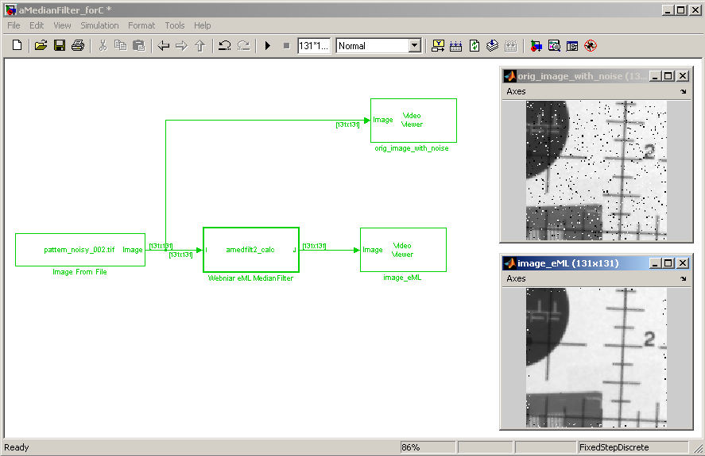
Original Adaptive Median Filter

Slide 8
Issues with the Original Model
The original MATLAB code is software oriented.
The following constructs are unsupported for HDL code generation:
Operates on the whole image
Includes nested for-loops with variable bounds and breaks
Combines filter algorithm and image modification code
Uses double types not synthesizable in hardware
Uses C math functions that cannot be mapped to hardware

Slide 9
Porting the Algorithm for HDL
Designing the hardware architecture
Serialize the image
Separate the filter computation
Parallelize the region computations in the algorithm
Optimize the median filter algorithm for hardware

Slide 10
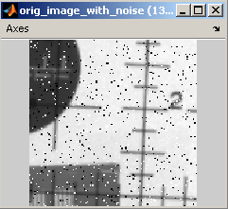
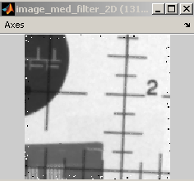
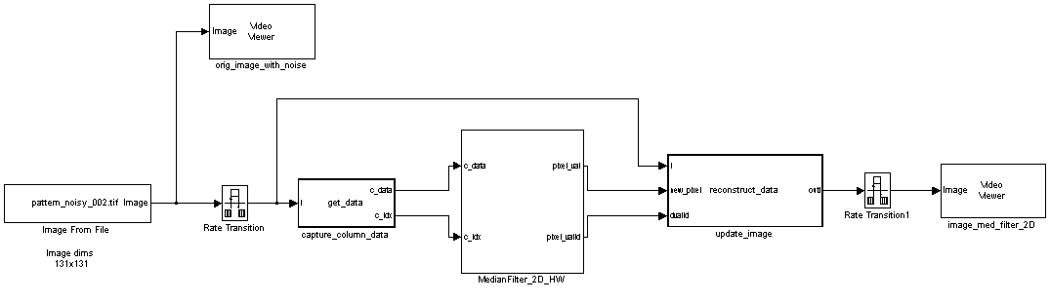
Adaptive Median Filter for Hardware
Adaptive
median filter
(compute median
pixel)
Partition
the image
Apply new pixel
or
Keep the old pixel

Slide 11
Partitioning the Image
This approach captures a column of data (9x1) of the image and feeds into the median filter.
The filter buffers the column for first 9 cycles to make a 9x9 region.
This is done to reduce the filter chip I/O count.
9x9 region of the image

Slide 12
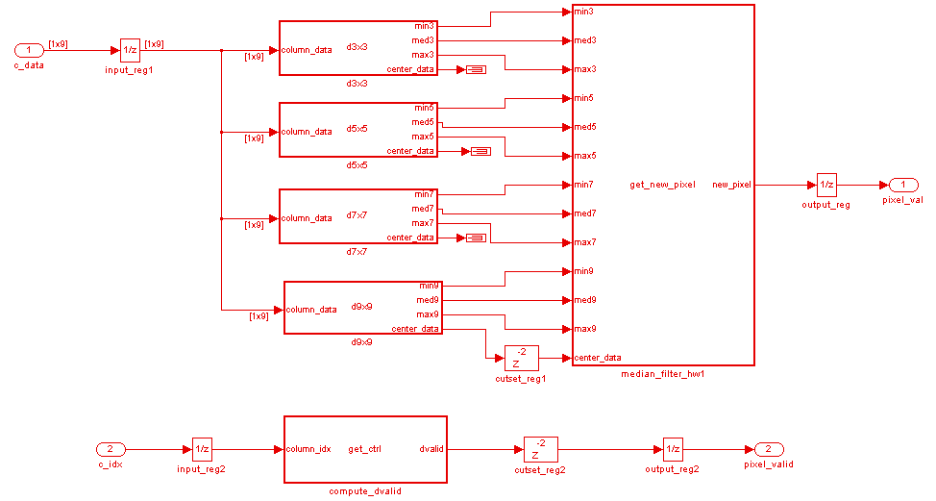

Median Filter Algorithm in Hardware
Fully parallel implementation

Slide 13
Filtering the Image Region
Buffers input column of data (9x1) for 9 cycles to make a 9x9 region
Partitions the buffer into 3x3, 5x5, 7x7, and 9x9 regions
Computes [min,med,max] pixel of each of the subregions
Computes output pixel using adaptive median algorithm
For each region, the adaptive median filter outputs:
‘center_pixel’ (data signal)
‘pixel_valid’ (control signal)
There is an initial 9-cycle delay in the center pixel computation at the begin of each scan line.
Subsequent center pixels computations do not have any delay.

Slide 14
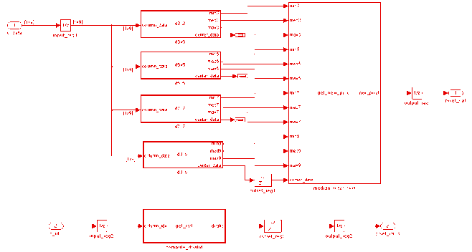
1D Median Filter
Structure of 1D Median Filter
3x3 region
min/max/median value computation for a 3x3 region requires 36 comparators (9 stages of 4 comparators each).
Each computational element compares the neighboring pixels (simple Mux in hardware that rearranges input pixels).
Adaptive median filter is very resource intensive.

Slide 15
1D Median Filter (Area Usage)
1D adaptive median filter resource usage:
3x3 region: 9 stages of 4 comparators = 36
5x5 region: 25 stages of 12 comparators = 300
7x7 region: 49 stages of 24 comparators = 1176
9x9 region: 81 stages of 40 comparators = 3240
Total number of comparators = 4752
To reduce resource usage, we adopted a less resource-intensive algorithm: the 2D median filter.

Slide 16
2D Median Filter
Apply 1D Filter
on Rows
then
Apply 1D Filter
on Columns
Is more area friendly
Uses one 1D median filter for each row and column of a pixel region
A 9x9 region would require 18 1D median filters
Provides big savings in area compared with 1D (but is less accurate)
Also helps to pipeline registers between row and column processing to increase frequency

Slide 17
Comparator Usage in 1D and 2D Filters
Size | 1D | 2D
3x3 | 9*4 (36) | 18 ((1*3*3)*2)
5x5 | 25*12 (300) | 100 ((2*5*5)*2)
7x7 | 49*24 (1176) | 294 ((3*7*7)*2)
9x9 | 81*40 (3240) | 648 ((4*9*9)*2)
Total | 4752 | 1060
2D filter is less accurate in pixel computation.
So we used this only 5x5, 7x7, and 9x9 regions, where there was big bang for buck.
To reduce error rate of pixel computation for 3x3, we still used 1D median filter.
This dramatically improved quality of output image because the noisy pixel being replaced was mostly found in the first 3x3 region.
Final area of the algorithm is (36 + 100 + 294 + 698 ➔ 1078).

